Slide 1
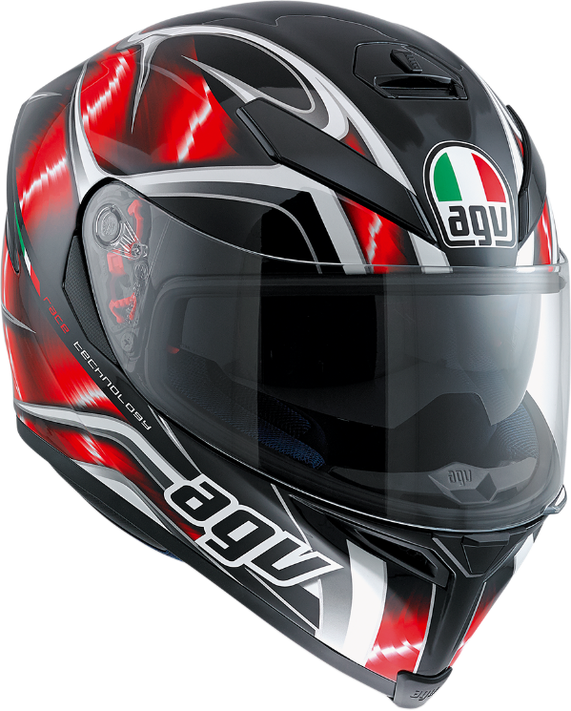
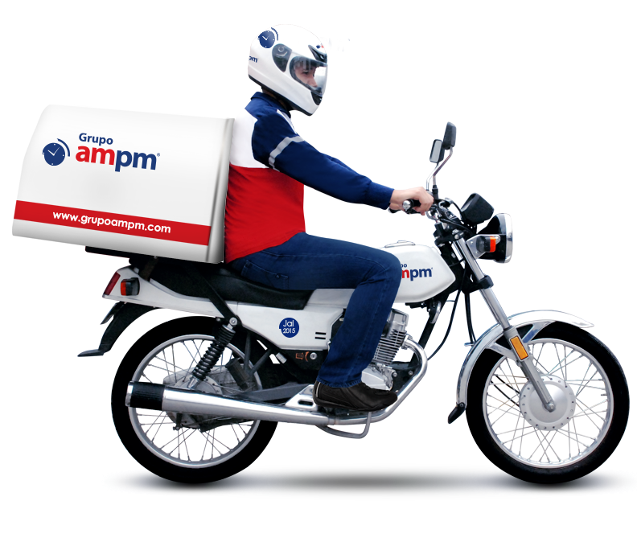
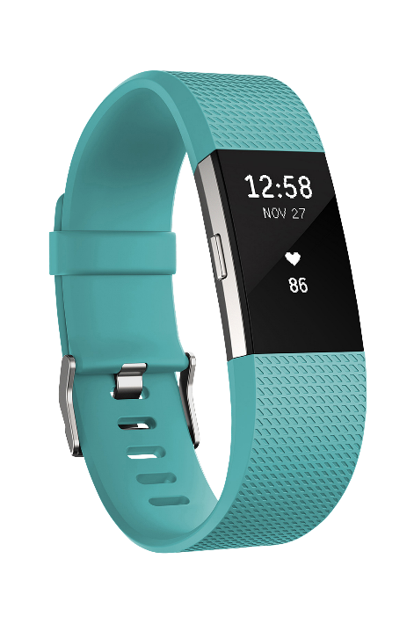
SST - BASED SMART HELMET FOR CYCLISTS AND MOTOR CYCLISTS
25-26J-294

Slide 2

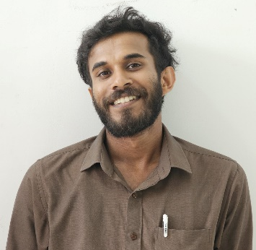
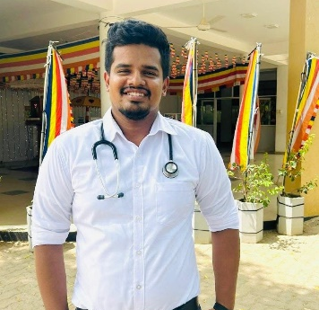


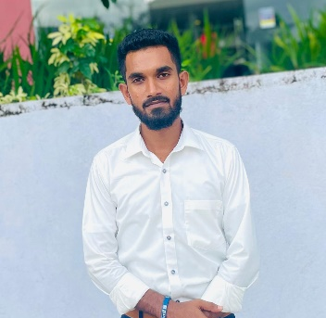

OUR TEAM
Supervisor
Co- Supervisor
External Supervisor
Mr. Jagath Wickramarathne
Mr. Amila Nuwan Alexander
Dr. Sajith Perera
Vithanage K.W.Y.L.N.
Samarakoon S.S.A.D.S.B
Samarasinghe K.P.C
Primasha W.G.R
IT22595980
IT22207036
IT22608086
IT22216878

Slide 3
PP2 Feedback & Strategic Actions
PP2 Comments
Actions Taken
Sensor Damage
Redesigned sensor housing for Exterior mounting to maintain shell structural integrity
Internal integration damages the helmet shell, compromising protection.
Speaker Safety
In-helmet speakers are harmful and distracting for drivers during motion.
Removed all internal speakers. Audio alerts now strictly routed via Mobile Application.

Slide 4
PROBLEM & MOTIVATION
THE PROBLEM: The "Safety Gap"
THE MOTIVATION: Intelligent Prevention
Passive Protection
Proactive Safety
Traditional helmets only minimize damage after a crash they do nothing to prevent it.
Transforming the helmet from a reactive shell into an AI-driven preventative system.
Invisible Risks
Physiological Insight
Critical factors like rider stress, fatigue, and mental distraction are currently unmonitored.
Using EEG & BLE to provide real-time feedback on the rider's internal state.
Static Navigation
Predictive Guidance
Standard GPS lacks real-time, context-aware alerts for high-risk "Danger Zones".
Enhancing situational awareness through voice-guided risk assessments and personalized safety maps.

Slide 5
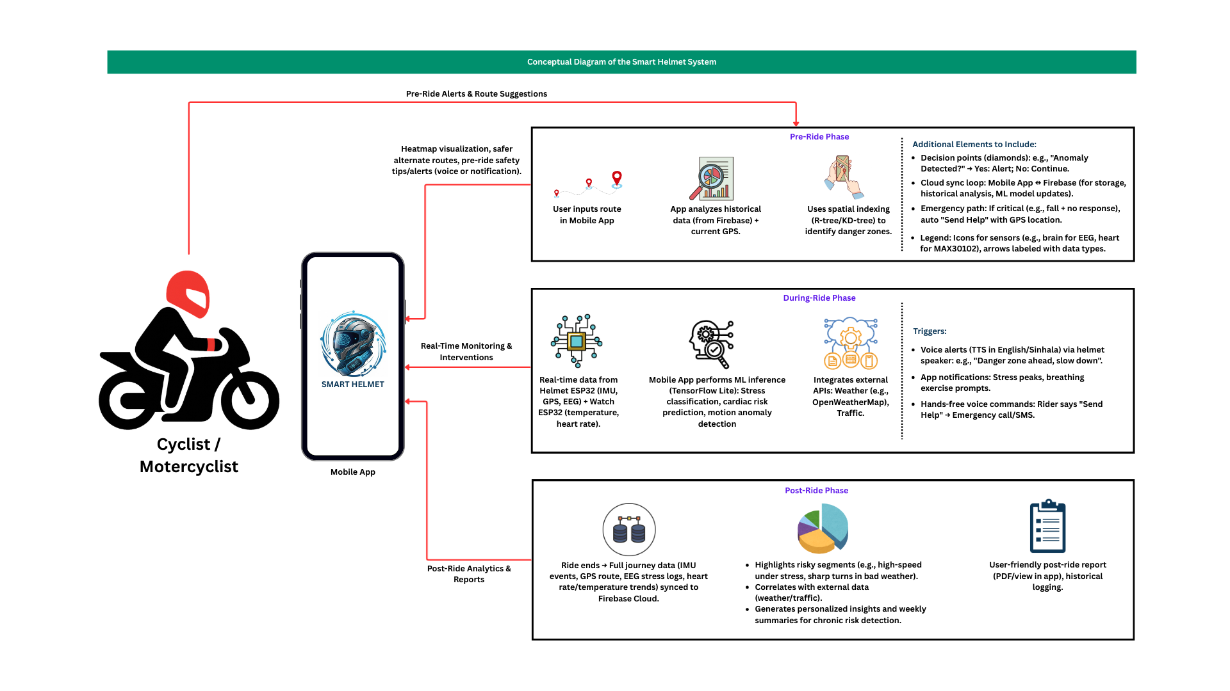
System Architecture & Integration

Slide 6
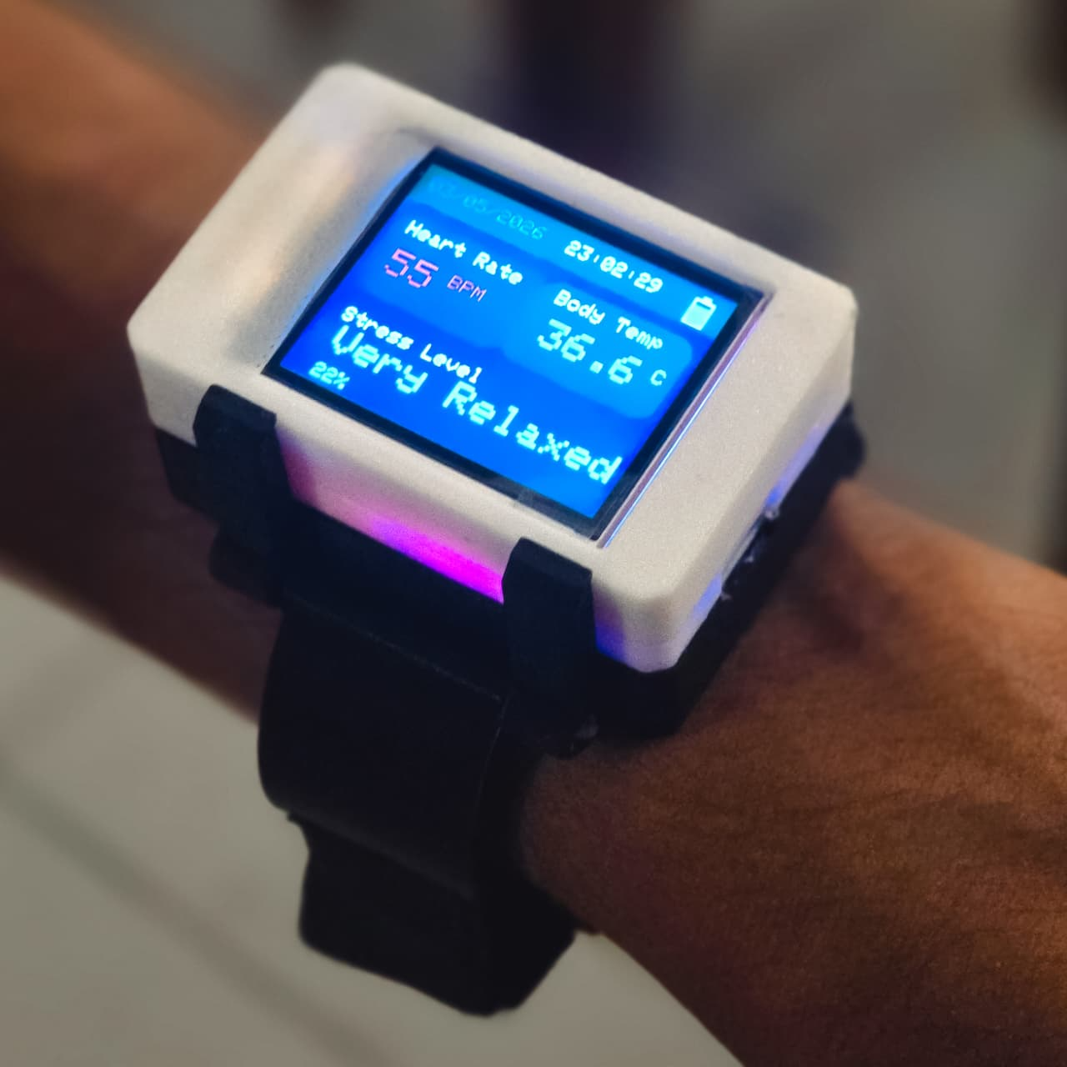
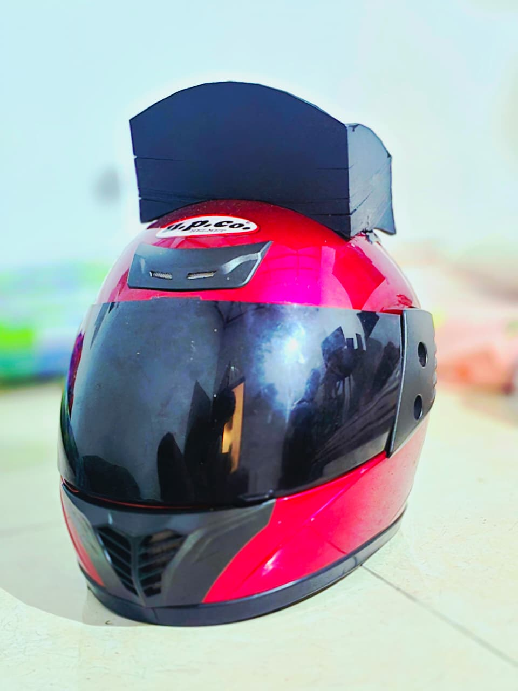
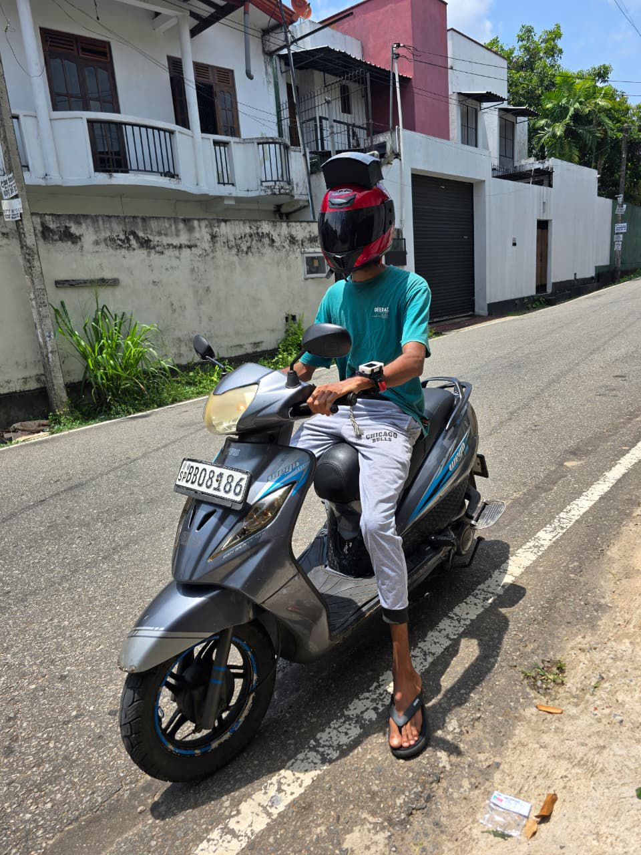
DATA COLLECTION
Watch
Helmet
Rider

Slide 7

HEALTH MONITORING
SYSTEM
IT22595980 | Vithanage K.W.Y.L.N
25-26J-294
BSc(Hons) in Information Technology Specializing in Information Technology
IT22595980| Vithanage K.W.Y.L.N. | 25-26J-294

Slide 8
Health Monitoring System
Built the predictive health analytics engine using longitudinal EEG and physiological sensor data to estimate cardiovascular risk scores for each rider session.
Integrated route-risk data with health parameters to generate personalised post-ride health reports and early-warning push alerts for high-risk riders.
Combined the health prediction engine with the route-risk model in the hybrid decision layer — the system now correlates rider physiological state with environmental danger to produce composite risk scores.
IT22595980| Vithanage K.W.Y.L.N. | 25-26J-294

Slide 9

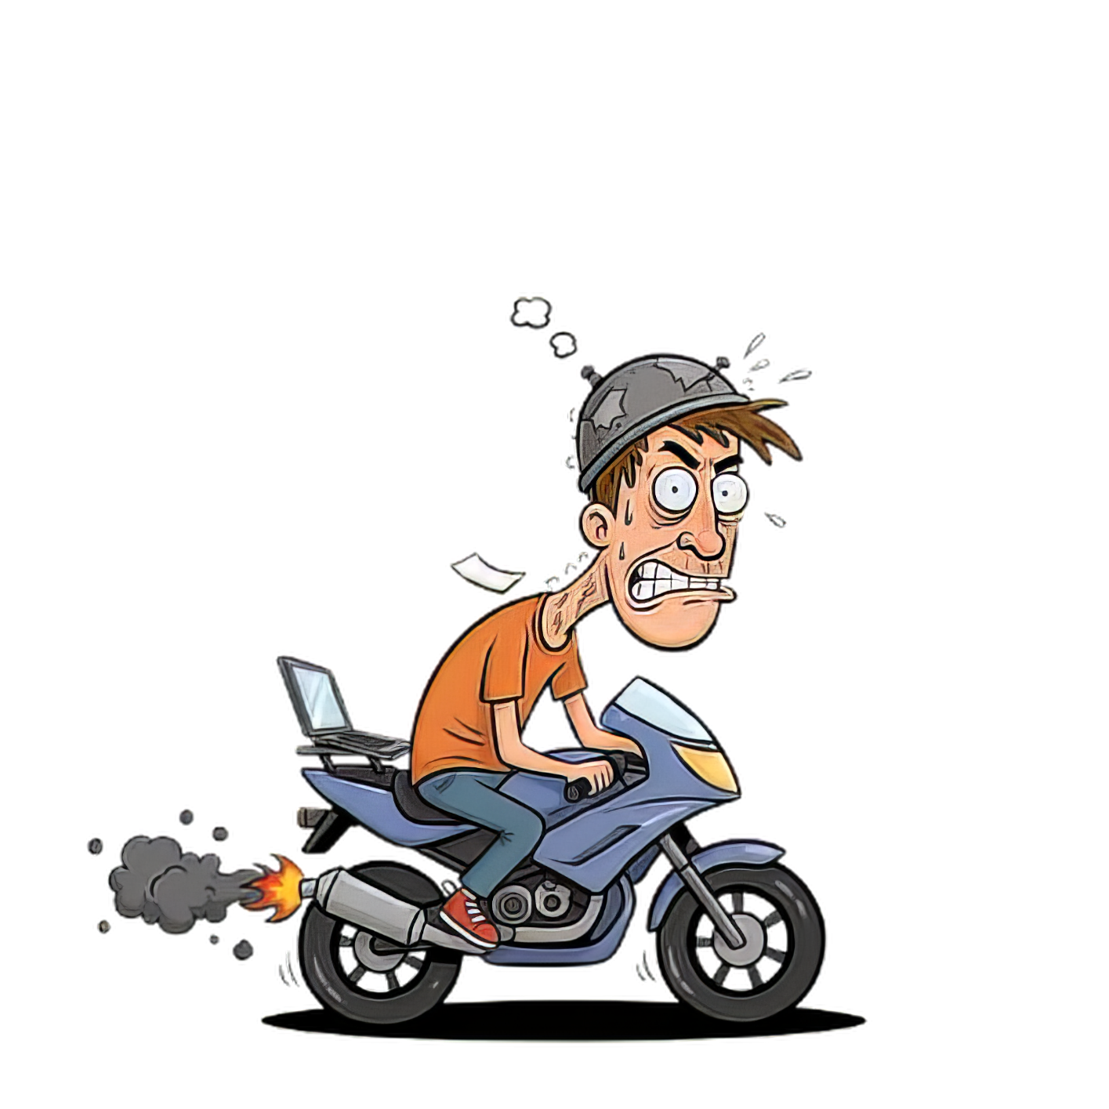
Emotion and Stress Monitoring with Real-Time Feedback
IT22207036 | Samarakoon S.S.A.D.S.B
BSc (Hons) in Information Technology Specializing in Information Technology
IT22207036 | Samarakoon S.S.A.D.S.B | 25-26J-294

Slide 10
Emotion and Stress Monitoring with Real-Time Feedback
Integrated EEG sensors into the helmet hardware and built a real-time brainwave signal acquisition pipeline using ESP32.
Trained an EfficientNetB0 CNN model classifying alpha/beta/theta/delta/gamma wave bands to detect cognitive fatigue and high stress. Achieved 88% classification accuracy.
Trained a second ResNet-based model to classify alert vs fatigue states and combined with the EEG pipeline to produce a hybrid real-time rider status output, enabling proactive voice alerts.
IT22207036 | Samarakoon S.S.A.D.S.B | 25-26J-294

Slide 11


Post Journey Risk Assessment And Report Generation
IT22608086 | Samarasinghe K.P.C
25-26J-294
BSc (Hons) in Information Technology Specializing in Information Technology
IT22608086| Samarasinghe K.P.C | 25-26j-294

Slide 12
Post Journey Risk Assessment And Report Generation
Designed and implemented the BLE communication protocol between the ESP32 helmet module and the Android mobile app. Achieved sub-200 ms end-to-end latency.
Built the live safety dashboard displaying real-time stress levels, Danger Zone alerts, route risk indicators, and push notifications.
Integrated voice-guided alerts via the mobile app speaker, ensuring zero screen interaction during riding. Field-tested across 20 Colombo urban routes, achieving 4.3/5.0 UAT satisfaction score.
IT22608086| Samarasinghe K.P.C | 25-26j-294

Slide 13


Danger Zone Detection & Voice-Guided Riding Assistant
IT22216878 | Primasha W.G.R
25-26J-294
BSc (Hons) in Information Technology Specializing in Information Technology
IT22216878 | Primasha W.G.R | 25-26J-294

Slide 14
Danger Zone Detection & Voice-Guided Riding Assistant
Danger Zone Identification & Route Risk Mapping
Developed a geospatial analytics module clustering historical incident data to auto-generate Danger Zone polygons on an interactive route safety map.
Implemented path-risk scoring logic that rates each road segment and triggers real-time voice alerts when the rider approaches a high-risk zone.
Combined YOLOv8 object detection with ResNet50 classification to create a hybrid route risk model, achieving >92% positional accuracy in Danger Zone alert triggering during field tests.
IT22216878 | Primasha W.G.R | 25-26J-294

Slide 15
LIMITATIONS & FUTURE IMPROVEMENTS
While traditional helmets effectively minimize damage post-collision, they remain fundamentally passive, failing to address the 'invisible risks' of rider fatigue, physiological stress, and dynamic environmental hazards.
Current Limitations
2
Future Scope
1
Limited battery life for continuous EEG monitoring and sensor pods sensitivity to extreme weather conditions.
Integration of flexible solar panels for self-charging and vehicle-to-helmet (V2V) mesh communication for enhanced mesh safety.
Commercialization
Target Market
3
4
B2B partnerships with insurance providers and urban delivery fleets for real-time risk assessment and insurance premium adjustments.
Urban motorcyclists & cyclists in Sri Lanka & South Asia.
Safety-conscious and student riders
Insurance companies, transport authorities, healthcare providers, Delivery riders (PickMe, Uber Eats)

Slide 16
FEEDBACK FROM USERS
"While the helmet is innovative, I found the built-in speaker uncomfortable during long rides. However, the voice guidance from the mobile app is much more user-friendly and easier to hear.“
Chamod Gallage
PickMe Rider
"The Smart Helmet has transformed my daily rides. The stress detection feature helps me stay alert, and the accident alert system gives me peace of mind on busy roads.“
Amila Lakshan
Uber Rider
"Excellent safety features! The real-time monitoring and voice alerts have significantly improved my riding experience. The mobile app is intuitive and very helpful.“
Sadeepa Chathuskara
PickMe Rider.

Slide 17
Thank You

